Slide 1


Multitasking in Java
Handling multiple tasks is Multitasking
As humans, we are good at multitasking. Our brains are capable of shifting the priorities between these tasks and still be able to perform all of them together with ease. In the same fashion, computers are designed to perform multiple operations in parallel so that different PROCESSES can execute in the system. For example we are able to play the music in our computer and still be able to work on a document.
Task1 - Speaking on phone
Task2 – Eating the food
Task1 - Speaking on phone
Task2 – Playing with child

Slide 2
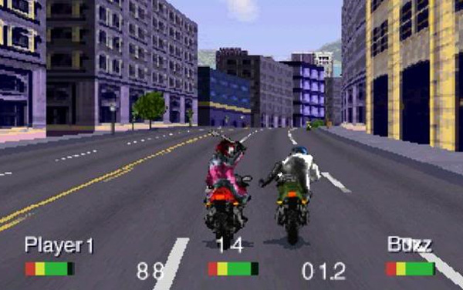
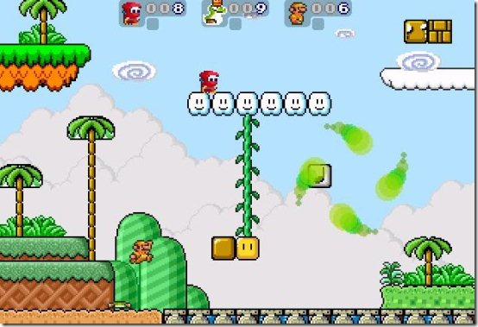
Multithreading in Java
Multithreading in Java gives the ability to execute code by different threads to perform tasks in parallel or as a separate task without waiting for other to complete.
Computer games are the best examples of the Multithreading concept. The ability to make different objects act on a platform is enabled with the concept of Multithreading.
Road Rash – you can see that there are different bike compete with you which are driven by the computer – They are nothing but threads running in the game application.

Slide 3


Multithreading in Java
Consider, we have a method “downloadFile” which helps in downloading the files when you give the URL, Using Multithreading we can download the multiple files parallelly using multiple threads calling the “downloadFile” method parallelly.
Public File dowloadFile(String URL)
{
//Code to download the file
return file;
}
1GB
200MB
500MB
100MB
Thread1
Thread2
Thread3
Thread4
Download all four files parallelly

